Slide 1
Air Pollution: California’s Journey in Air Quality
Alexa
Drapiza
Caroline Marques
David Henderson
Yuleica Ledezma
Notes:
Intro: Alexa

Slide 2
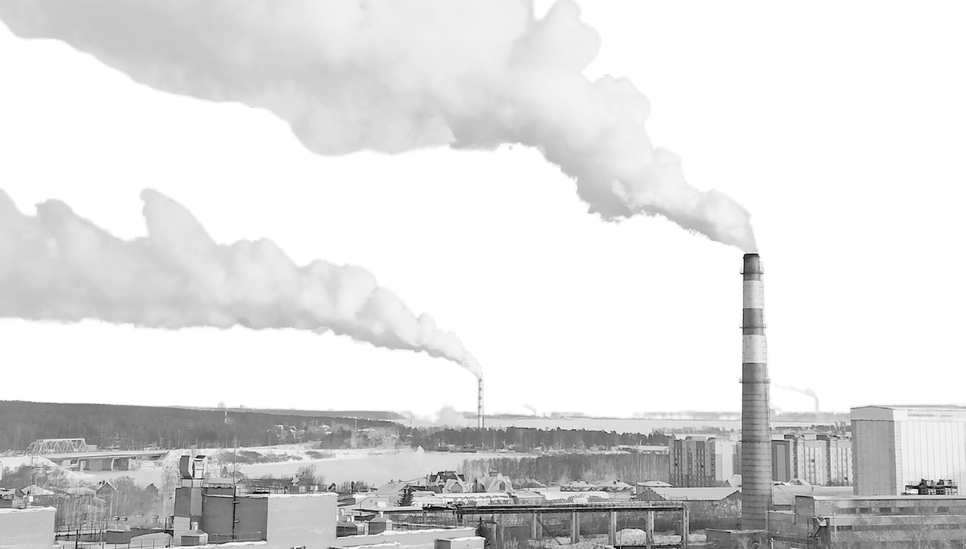
Table of Contents
The Invisible Health Threat
US Breakdown
California Breakdown
A History of CA’s Policies
Conclusion
Notes:
Alexa

Slide 3
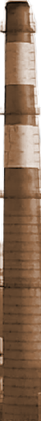
Table of Contents
The Invisible Health Threat
US Breakdown
California Breakdown
A History of CA’s Policies
Conclusion
Notes:
Alexa

Slide 4
The Invisible Health Threat
A Public Health Emergency
99% of the global population exposed to pollution levels above WHO recommendations.
Responsible for approximately 7 million premature deaths annually.
Affects not just the lungs, but the entire body, including the heart and brain.
Key Health Conditions Linked to Air Pollution
Ischemic heart disease
Stroke
Chronic obstructive pulmonary disease (COPD)
Lung cancer
Acute respiratory infections (e.g., pneumonia)
Global Economic Impact
^{$8T}
Public health costs represent
6.1% of global GDP (2019)
Source: https://www.who.int/news-room/feature-stories/detail/air-pollution--the-invisible-health-threat
Notes:
Alexa and David

Slide 5
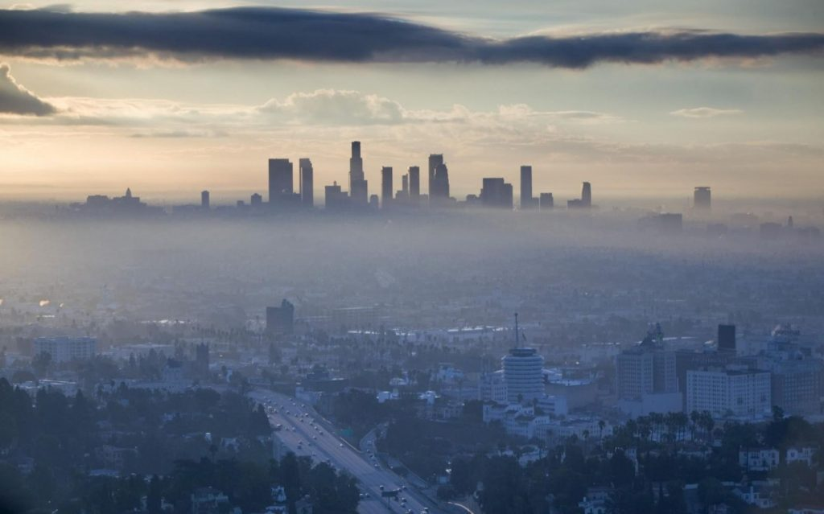
Why focus on the pollutants and why California?
The Invisible Health Threat

Slide 6
Table of Contents
The Invisible Health Threat
US Breakdown
California Breakdown
A History of CA’s Policies
Conclusion

Slide 7
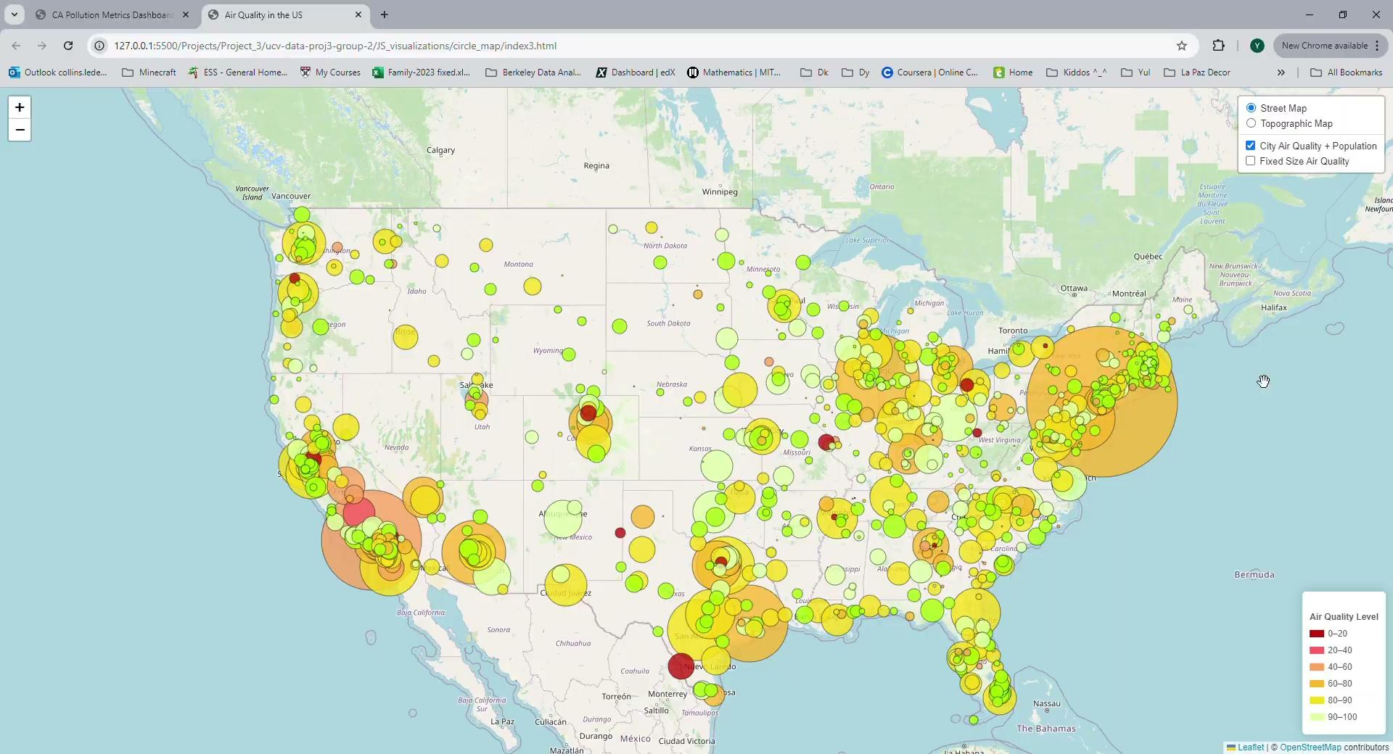
US Breakdown | (Call Out)
Notes:
Yul’s 1st visual - air quality
We analyzed air quality across various cities in the US, using an index where 0 in red represents poor air quality and 100 in green indicates excellent air quality. A key finding is the correlation between population size and pollution levels: larger cities, like New York and Los Angeles (represented by larger circles), tend to have poorer air quality, while smaller cities generally show better air quality. However, we identified several outliers.
One intriguing area of focus is the California Central Valley. Despite its relatively smaller population, air quality is worse than expected. Further investigation revealed that the region’s topography plays a significant role. The surrounding mountains trap pollution, limiting airflow and increasing pollution levels. This highlights that factors beyond population size, such as geography, significantly impact air quality.

Slide 8
Table of Contents
The Invisible Health Threat
US Breakdown
California Breakdown
A History of CA’s Policies
Conclusion

Slide 9
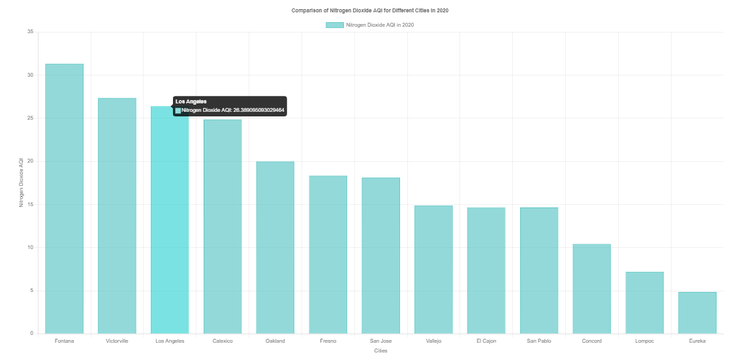
California City Comparison
California Cities Breakdown | (Call Out)

Slide 10
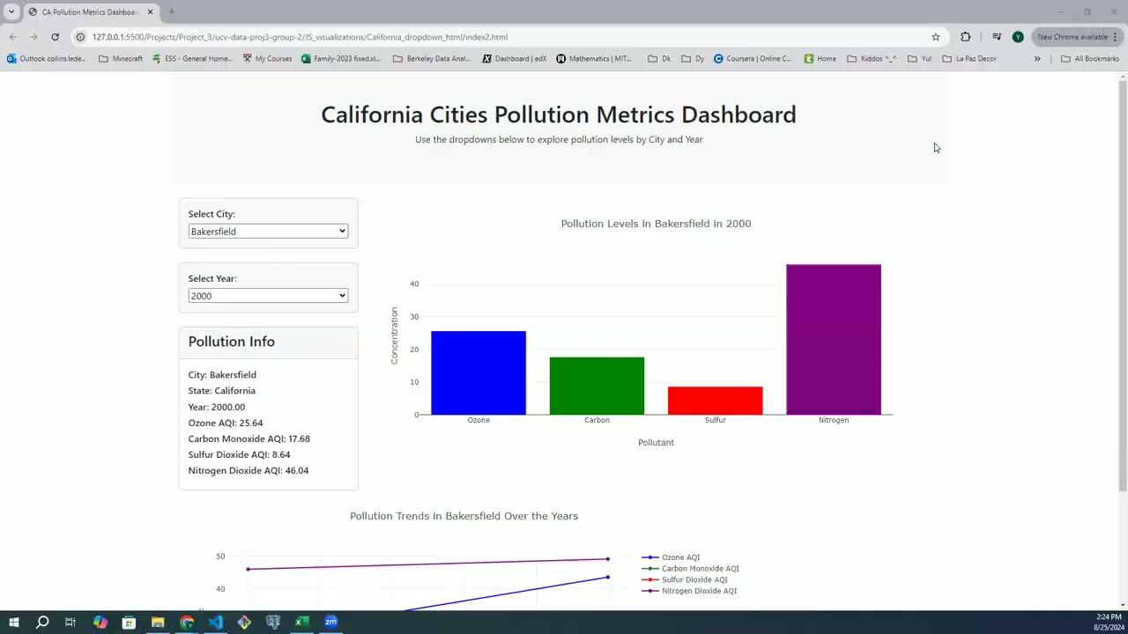
California Cities Breakdown | (Call Out)
Pollutants:
Ozone (O3): Key component of smog; high levels cause respiratory problems.
Carbon Monoxide (CO): Produced by incomplete combustion of fuels; impairs oxygen delivery in the body.
Sulfur Dioxide (SO2): Results from burning fossil fuels; linked to asthma and emergency hospital visits.
Nitrogen Dioxide (NO2): Produced by high-temperature fuel combustion; exacerbates respiratory illnesses.
Notes:
Yuls 2nd Visual - Dashboard on gasses in particular CA cities - David’s speaking on this ** find transition into carolines

Slide 11
Table of Contents
The Invisible Health Threat
US Breakdown
California Breakdown
A History of CA’s Air Policies
Conclusion

Slide 12
California | History of Air Quality Management
In 1984, California began its Smog Check program, requiring that vehicles conform to air pollution emissions standards. By the program's one-year anniversary, tailpipe emissions were down by 17%.
RECLAIM, the Regional Clean Air Incentives Market, is established by a South Coast AQMD as the state's first cap-and-trade program, imposing overall limits on facilities that were some of the largest emitters of ozone and particulate matter precursors.
In 2017, AB 617 was signed into law, developing a community focused program to protect public health based on the principle of environmental justice.
In 1947, the Los Angeles County Air Pollution Control District was formed. Soon after, the Bay Area Air Pollution Control District was established in 1955. They were the first bodies in the nation established to control air pollution regionally.
1947
1984
1993
2017
1903
1967
1988
1999
2018
Air pollution became so bad in Los Angeles that residents mistook it for an eclipse, causing Los Angeles City County to begin adopting measures to combat smoke emissions.
In 1967, the California Air Resources Board (CARB) was established to unify the state's actions against air quality.
The California Clean Air Act was adopted, establishing air quality guidelines more stringent than federal ones.
In 1999, along with beginning to monitor PM2.5, the Bay Area AQMD Board of Directors adopted the guiding principle of environmental justice: that no community should bear disproportionately high health impacts of air pollution.
The Coalition for Clean Air - a statewide organization working exclusively on air quality issues - launches the first ever California Clean Air Day, a statewide effort to highlight the things individuals a and organizations can do to clear the air.
Source: https://www.aqmd.gov/home/research/publications/50-years-of-progress
Notes:
Caroline

Slide 13



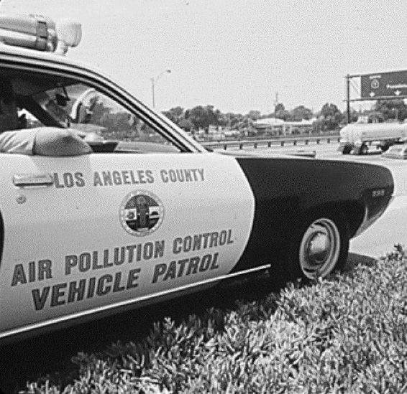



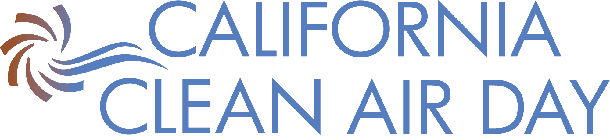

California | History of Air Quality Management
AB.617
RECLAIM
1947
1984
1993
2017
1903
1967
1988
1999
2018
ACT
Source: https://www.aqmd.gov/home/research/publications/50-years-of-progress
Notes:
Caroline -

Slide 14
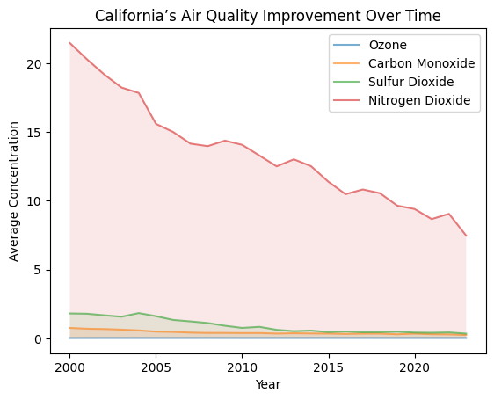
California | Air Quality
California is the third-most carbon-efficient state, after New York and Massachusetts;
California’s carbon intensity is 8.8% lower than the national average, according to the report;
In 2020 California has reduced emissions by more than 4%;
The transportation sector, the largest source of GHG emissions in the state, saw a 10.2% reduction in emissions compared to pre-pandemic levels in 2019.
Since 2000, emissions from in-state electricity generation have decreased by 27.7%.
Notes:
Caroline -

Slide 15
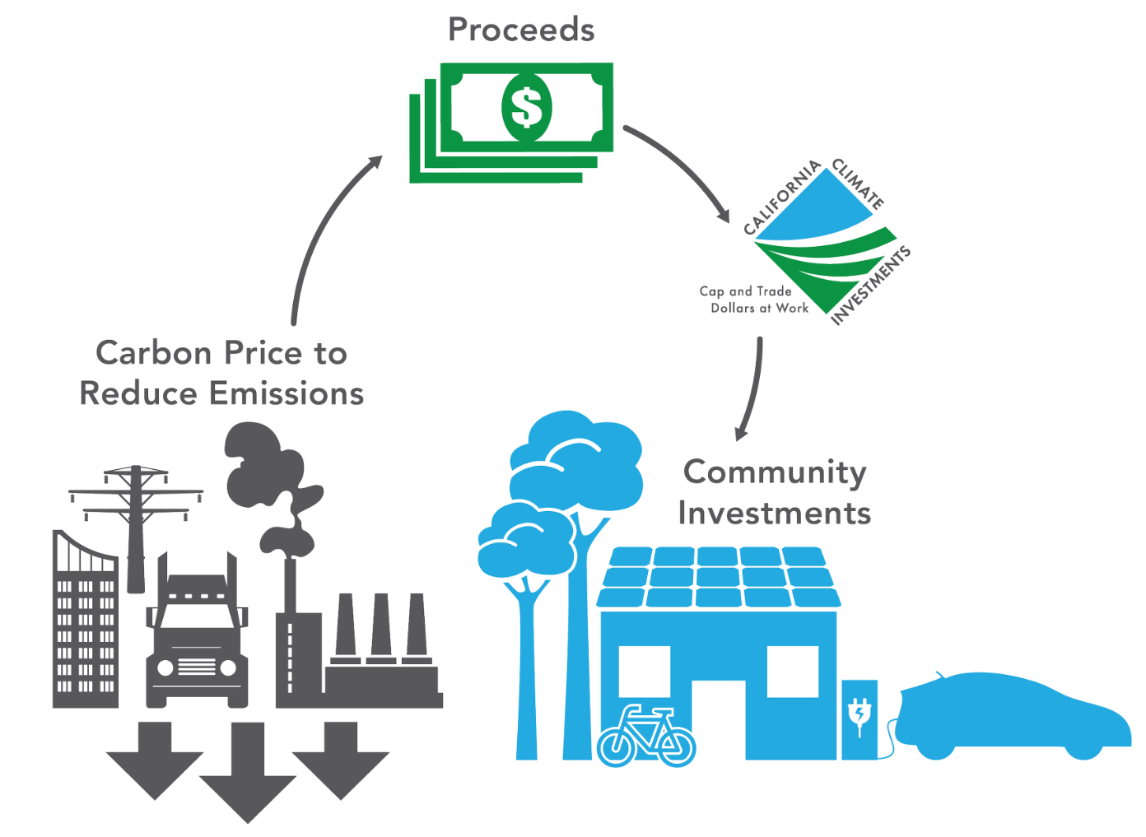
California | Pollution Reduction Plan
Goal: Achieve carbon neutrality by 2045
Pollution Reduction
Cut greenhouse gas emissions by 85% by 2045
Reduce oil consumption by 94% and fossil fuel use by 86%
Lower air pollution by 71%
Clean Energy Targets
20 GW offshore wind capacity by 2045
3 million climate-friendly homes by 2030; 7 million by 2035
Install 6 million heat pumps by 2030
Community and Policy Integration
Stringent laws and fiscal incentives to support clean technologies
Strong community engagement and public education efforts
Results
Significant reduction in greenhouse gas emissions and air pollution.
Innovation in clean technologies and energy systems.
Source: https://archive.gov.ca.gov/archive/gov39/wp-content/uploads/2018/09/9.10.18-Executive-Order.pdf
Notes:
Caroline -

Slide 16
Table of Contents
The Invisible Health Threat
US Breakdown
California Breakdown
A History of CA’s Policies
Conclusion
Notes:
Alexa

Slide 17
Conclusion
The main pollutants are Ozone (O3), Carbon Monoxide (CO), Sulfur Dioxide (SO2) and Nitrogen Dioxide (NO2)
California’s Pollution Reduction plan has improved air quality over the years
Emission control and other policies implemented by the EPA has helped improve air quality nation-wide and specifically California
The US has reduced NO2 levels by 73% since 90s
Notes:
Alexa

